Slide 1
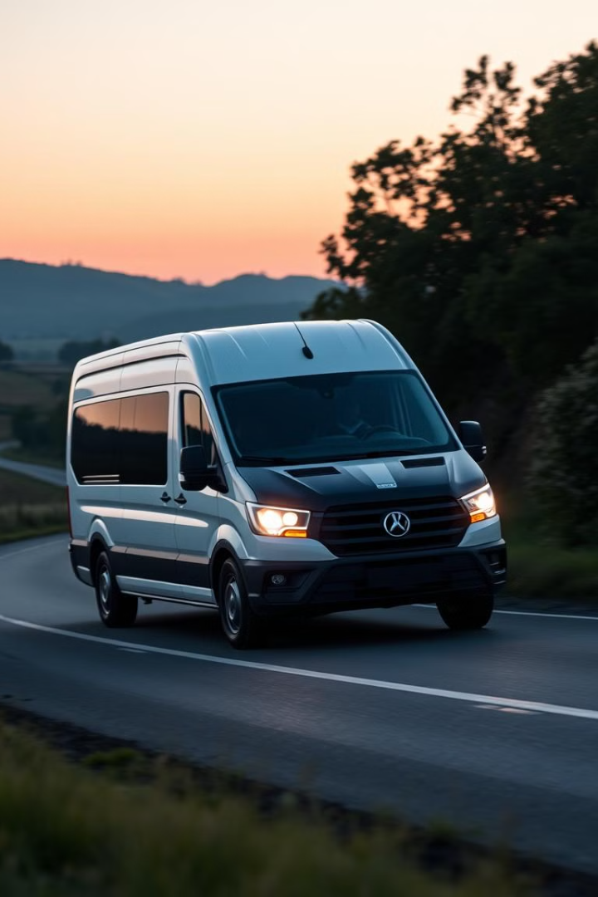
Van Assignment Project
This presentation will walk you through the Van Assignment Project, a practical application of data structures and programming concepts. We will explore the code's main features, key syntax, and the role of structs and arrays.

Slide 2
About the Project
Purpose
Implementation
The Van Assignment Project aims to streamline student transportation by managing van assignments based on time and route. It allows students to choose their preferred schedule and displays a list of assigned students.
The project utilizes structs and arrays for data storage, ensuring efficient management of student details and van capacity. It also incorporates input validation to ensure data accuracy and consistency.

Slide 3
Understanding the Code – Main Features
1
Data Definition
2
Input Validation
The code defines van capacities and student details using a struct to store student name, time, and route information. It preloads data for 14 students and allows the 15th student to input their details.
The code ensures valid choices for time and route, preventing invalid inputs and maintaining the integrity of the assignment data. It displays an updated list of assigned students after each input.

Slide 4
Key Syntax and Code Structure
Headers
Namespace
Struct Definition
The code utilizes the standard input/output library (\`#include \`) and the string library (\`#include \`) for input and output operations, and string manipulation, respectively.
The code utilizes the standard namespace (\`using namespace std;\`) for easy access to standard library elements.
The code defines a struct named \`Student\` with member variables for \`name\`, \`time\`, and \`route\`, representing student details.

Slide 5


Key Syntax and Code Structure
Student Data
User Input
The code uses an array of structs named \`students\` to store the details of all students. Each element in the array represents a student, with individual fields for name, time, and route.
The code prompts the user to enter their name using \`cin.ignore()\` and \`getline(cin, ...)\` to handle potential newline characters and capture the full name.

Slide 6
Key Syntax and Code Structure
1
Time and Route Validation
The code validates the user's time and route choices using conditional statements (\`if\` and \`else if\`) to ensure valid options are selected. If the choice is invalid, the student's time or route is set to "Not Assigned".
2
Data Display
The code uses a loop to iterate through the \`students\` array and display each student's name, time, and route, presenting a clear and concise overview of the van assignments.

Slide 7

Thank You!
We hope this presentation has provided a comprehensive overview of the Van Assignment Project. Feel free to ask any questions you may have about the code, its features, or the implementation of data structures.

